Slide 1
CNS TUBERCULOSIS IMAGING AND SURGERY

Slide 2
Tuberculosis
As old as recorded history
Symptoms described in the Rig Veda (1500 BC)
Unequivocal lesions in Egyptian mummies
Odier, Ford described meningeal TB 1790
Surgical excision Wernicke and Hahn 1882,

Slide 3
Tuberculosis
CNS tuberculosis complicates 10% of all TB
Never the first manifestation
Occurs within 6-12 months
Circle of Willis more frequently involved than the basilar system

Slide 4
Mycobacterium tuberculosis
Acid fast bacillus
Does not stain on gram stain
Obligate aerobes
Difficult to grow
High lipid in cell wall
Hominis/ Bovine/ Avium

Slide 5
Pathogenesis
May develop during initial infection/ reactivation
Haematogenous dissemination
    Commonest
    Focus in brain (Rich focus)
    Rupture of focus into subarachnoid/ ventricular space
Contiguous spread

Slide 6
CNS tuberculosis
Intracranial
    Parenchymal
    Meningeal
    Osseous
Spinal
    Parenchymal
    Meningeal
    Arachnoiditis
    Osseous

Slide 7
Epidemiology
Incidence varies blacks > whites
Predominantly in the young (50% <10)
Abscess in 4-8% (20% with HIV)

Slide 8
Pathology
Immature lesions – multiple tubercles in oedematous brain
Mature: avascular mass, nodular extensions, yellowish gritty casseous areas
60% attached to dura

Slide 9
Pathology (parrenchymal)
Can be present anywhere
Cerebellum in children
Cerebral hemisphere and basal ganglia commoner in adults

Slide 10
Pathology (tuberculoma)
Tuberculoma ( classical lesion)
Tuberculoma en plaque
Tuberculous abscess
Cystic tuberculoma
Multiple grape like tuberculoma
Microtuberculoma
Calcified tuberculoma
Tuberculous encephalopathy

Slide 11
Pathology (tuberculoma)
Dastur described six main types
    Parenchymal changes.
        (1) Ventriculitis
        (2) Border-zone encephalitis
        (3) Infarction
        (4) Internal hydrocephalus
        (5) Diffuse oedema
        (6) Tuberculoma

Slide 12
Pathology (meningeal)
Classically Commonest in 6m – 3 years
Now adults 50%
Thick exudate encasing nerves, vessels
HCP, tuberculoma, arachnoiditis
Diffuse perivasculitis
Infarcts
Pachymeningitis

Slide 13
Diagnosis
Montoux test
Hb/ ESR
CXR
ELISA
CSF
PCR
Imaging
Biopsy

Slide 14
Imaging
X ray
Angiography of historical significance
CT
MRI

Slide 15
Imaging
Tuberculoma
    Typically cortical and subcortical
    Multiple in 10-35%
    Milliary rare ( children)
Meningitis (commonest form of CNS TB)
    Isolated meningitis is rare (5% in children)
    Basal cisterns

Slide 16
Imaging (CT tuberculoma)
Cerebritis: hypodense areas
Perilesional oedema out of proportion
Early tuberculoma: iso to slightly hyper dense , ring enhancement
Evolved : well delineated ring enhancing mass, target sign (central enhancement or calcification)
Healed: often calcify
Manifestations
    Small disc/ rings
    Large rings with central lucency
    Large nodular mass with irregular outline
    Multiple lesions in 15-20%

Slide 17
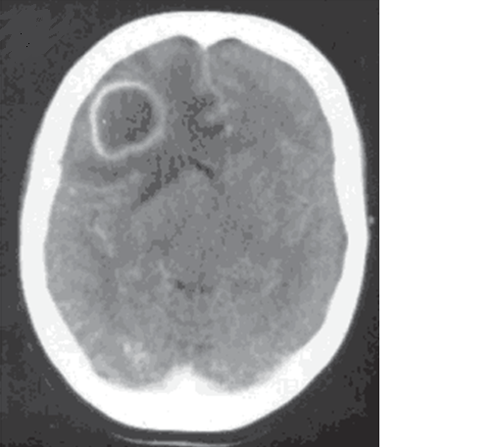
Caseating tuberculosis granuloma involving the right frontal lobe. CECT shows a rim-enhancing lesion in the right frontal lobe consistent with a caseating tuberculosis granuloma

Slide 18
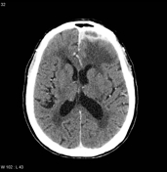
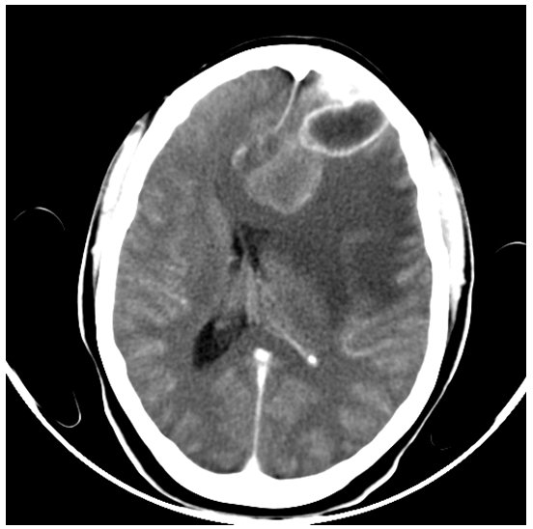

Slide 19
Imaging (MRI tuberculoma)
T1 : isointence
T2: central hyper with hypo ring
Marked thin rim enhancement
Hypo on T2: fibrosis, gliosis, macrophage infiltration

Slide 20
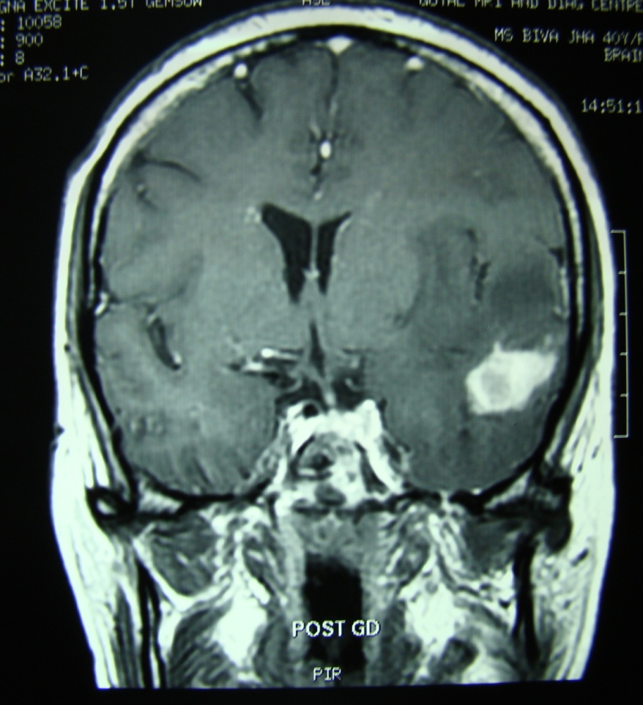
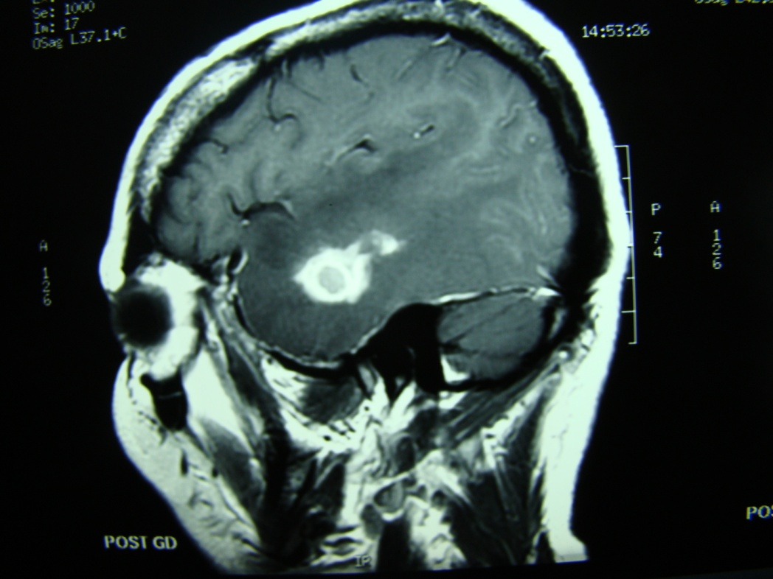
Parrenchymal tuberculosis. contrast-enhanced T1-weighted MR image demonstrates multiple enhancing caseating and non-caseating tuberculomas, predominantly within the left frontal and parietal lobes

Slide 21
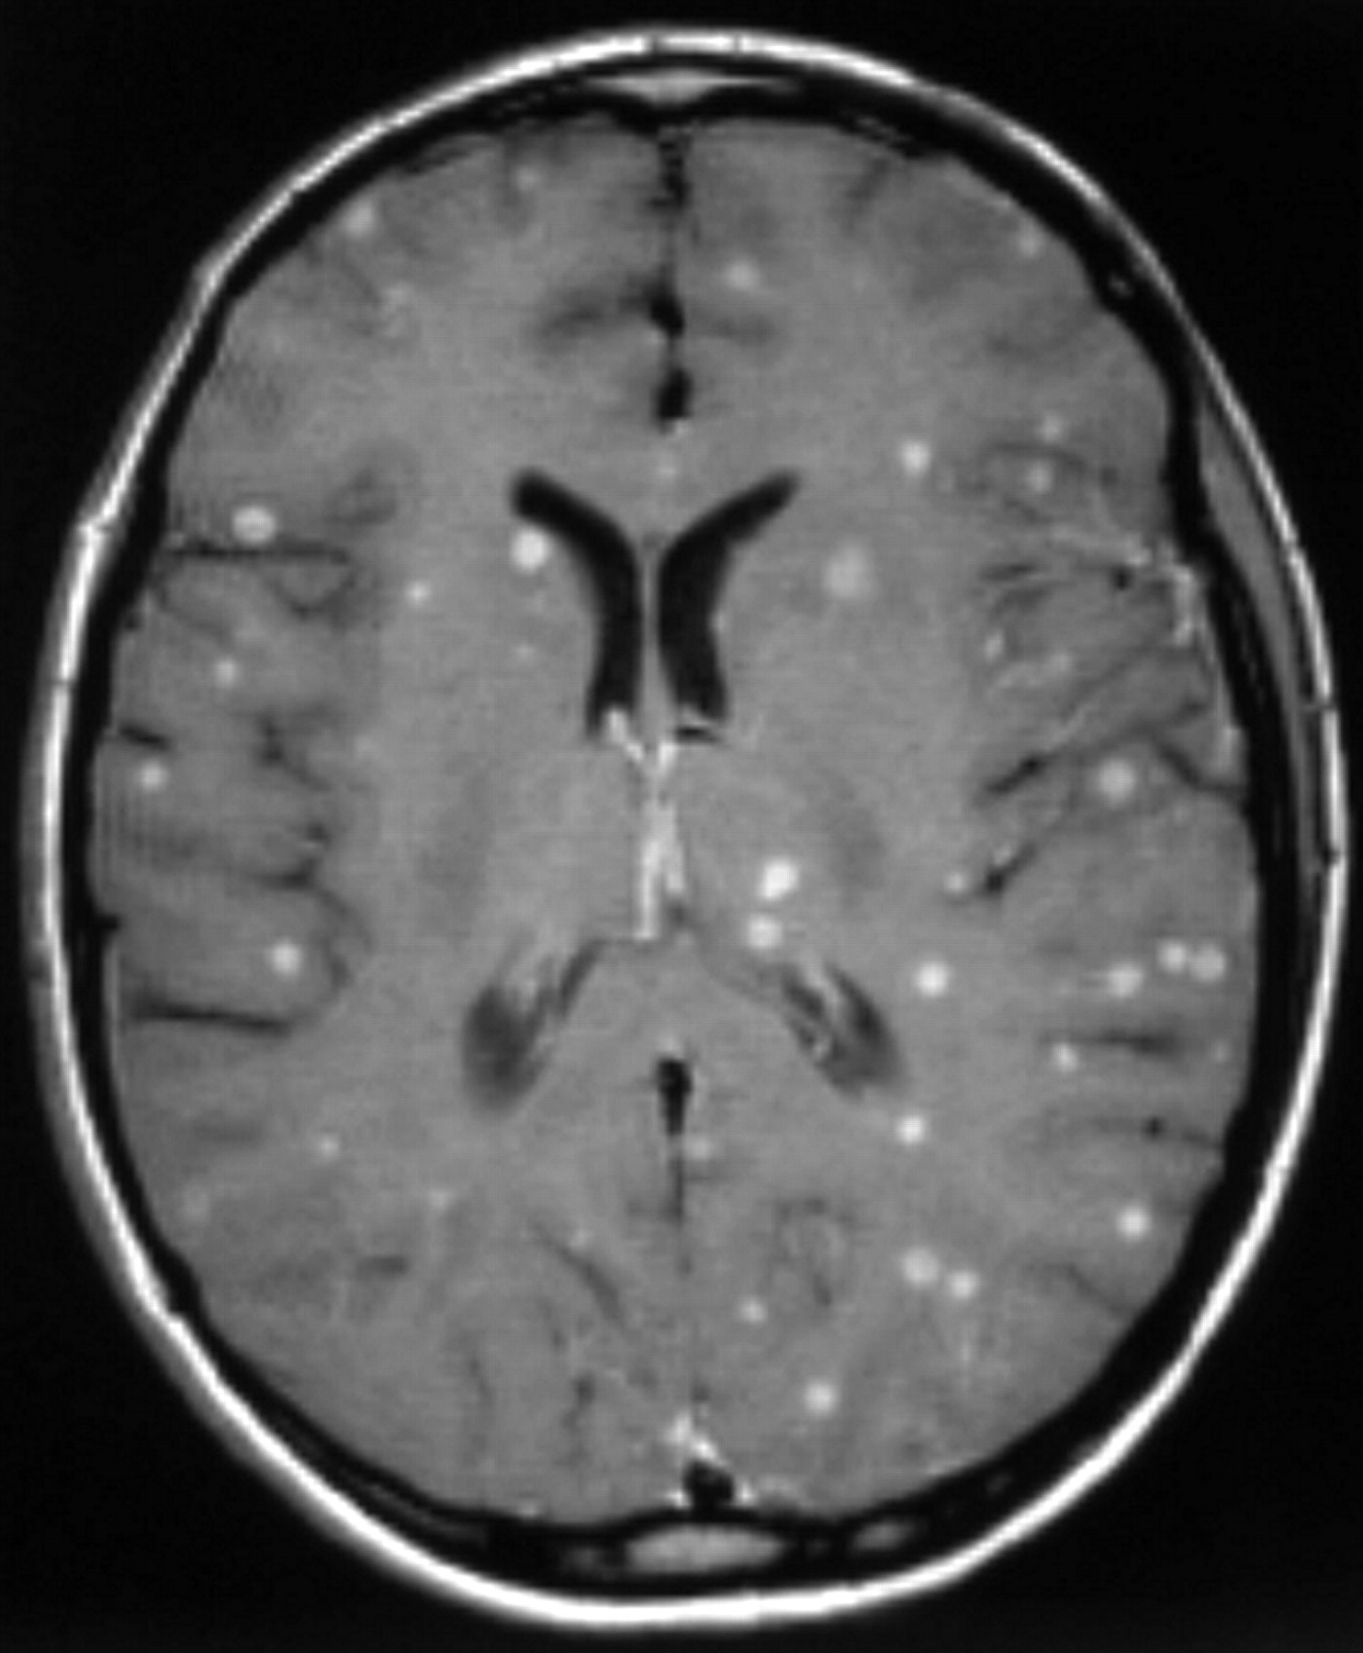
Milliary CNS tuberculosis. Axial contrast-enhanced T1-weighted MR image shows multiple small high-signal-intensity foci within both cerebral hemispheres

Slide 22
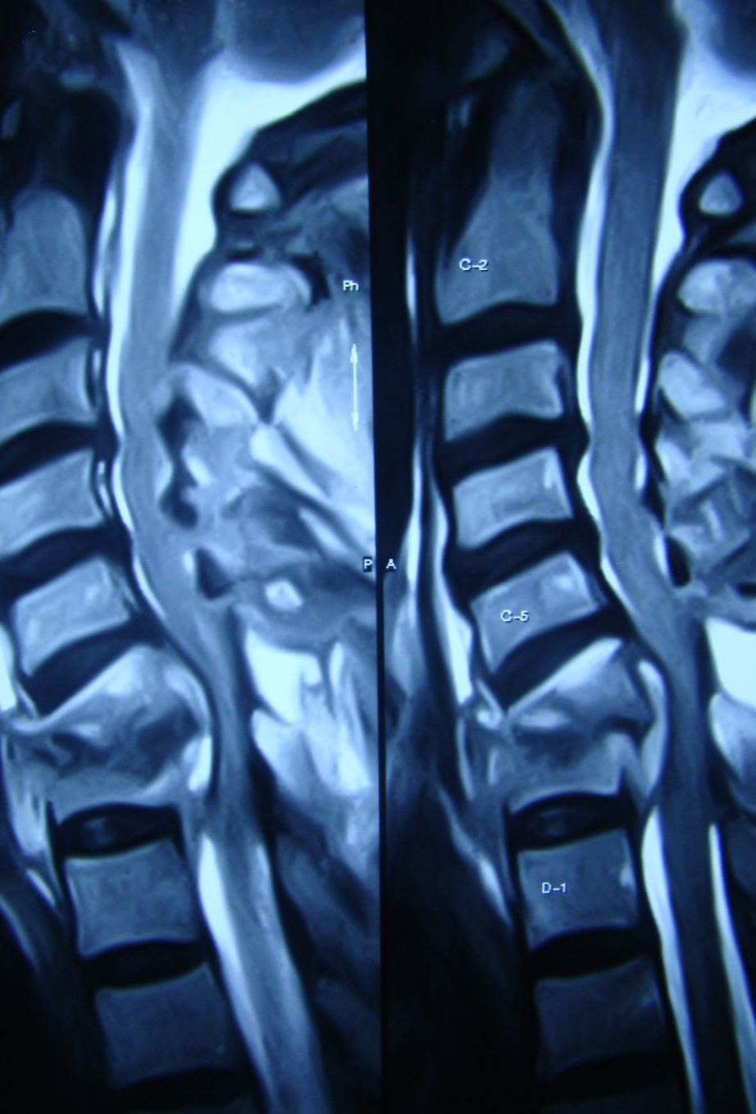

Slide 23
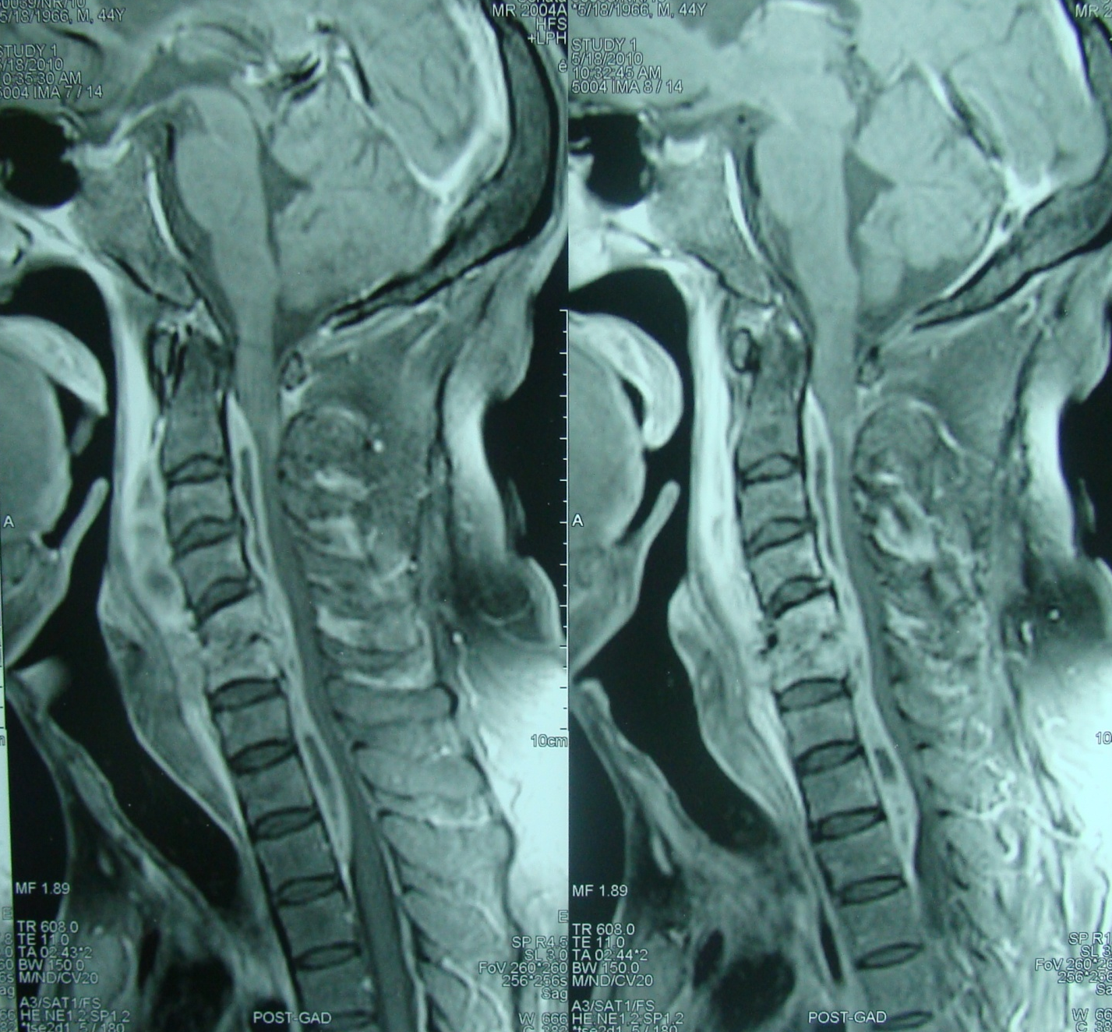

Slide 24
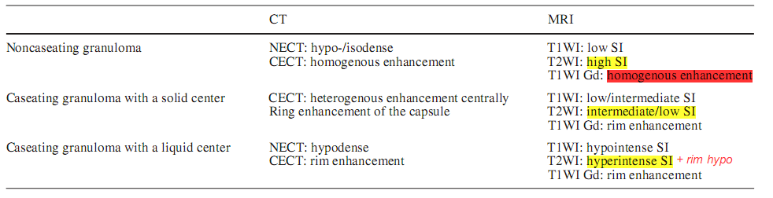
A. Bernaerts, F. M. VanhoenackerTuberculosis of the central nervous system: overview of neuroradiological findings. Eur Radiol (2003) 13:1876–1890

Slide 25
Imaging (meningitis)
Active
Sequelae
  Hydrocephalus
  Ischemia and infarction
      Medial lenticulostriate 75%
      Thalamoperforating
      Cortex 25%
      Bilateral 70%
  Atrophy
  Calcification

Slide 26
Imaging (CT meningitis)
NCCT:
    scans may be normal
    Obliteration of basal cisterns by hypo/ iso dense exudate
    en plaque dural thickening
    Popcorn calcification
    Hydrocephalus
    Sequelae of chronic meningitis
      Infarcts
CECT:
    Abnormal meningeal enhancement (may persist)
    Leptomeningeal enhancement sylvian fissures, tentorium
    Granulomas in the basal meninges
    Ependymitis

Slide 27
Imaging (MRI meningitis)
Unenhanced scan: does not show active meningitis
  Spine
    CSF loculations
    Obliteration of arachnoid space
    Loss of cord outline in cervicodorsal cord
    Thickening and clumping of roots in the lumbar cord
Contrast T1 : basal meningeal enhancement
  spine
    Linear enhancement of cord/ roots

Slide 28
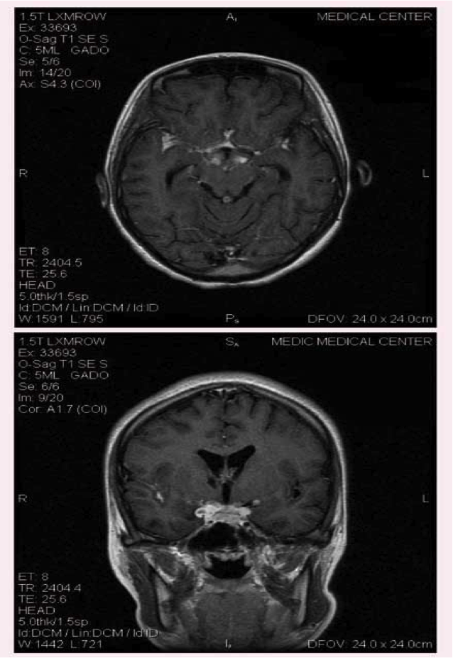
Tuberculous meningitis. Axial contrast-enhanced T1-weighted magnetic resonance (MR) image shows florid meningeal enhancement.

Slide 29
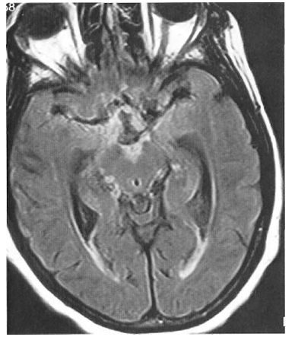
Tubercular meningitis. Axial FLAIR-MR] showing marked hyperintensity of the basal cisterns and prominent temporal horns in a patient with mild communicating hydrocephalus

Slide 30
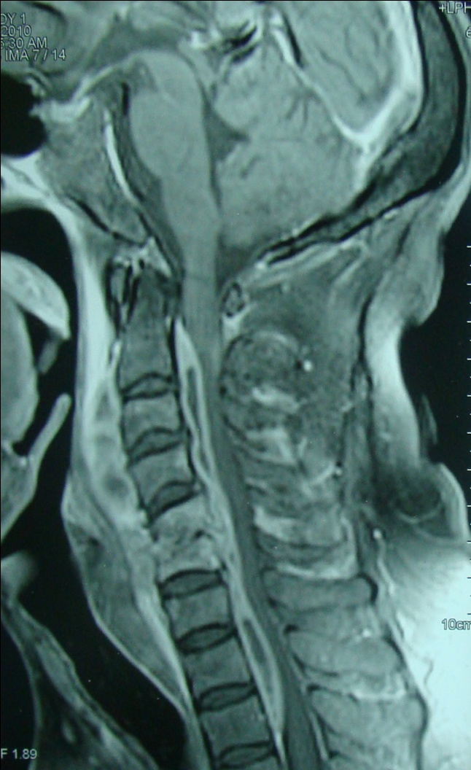
Tubercular spondylitis with epidural and retroabscess

Slide 31
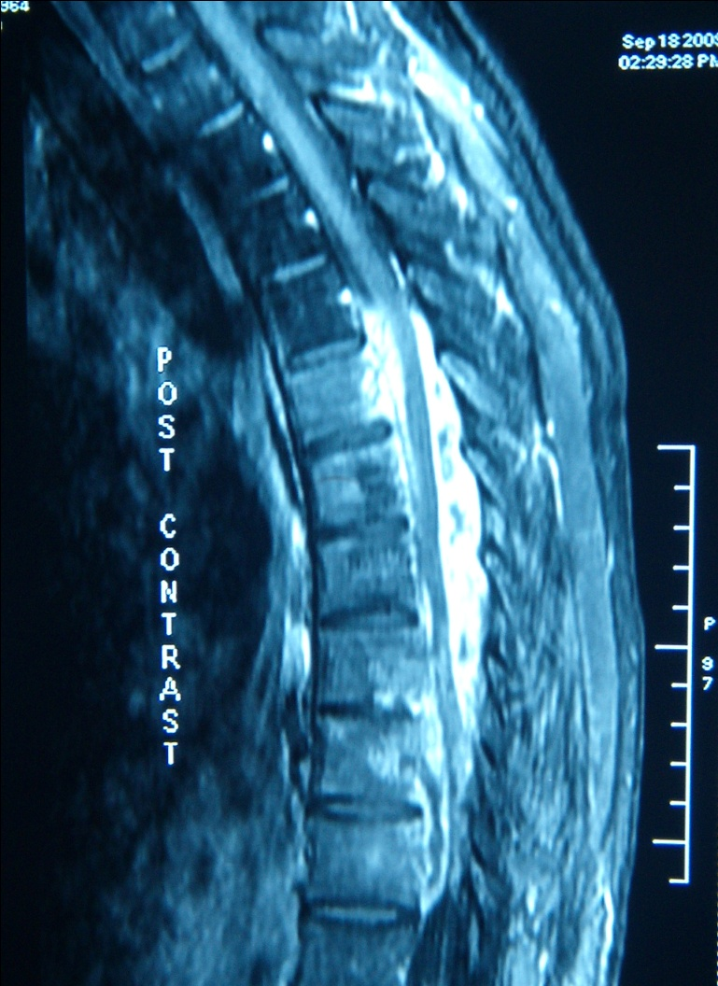
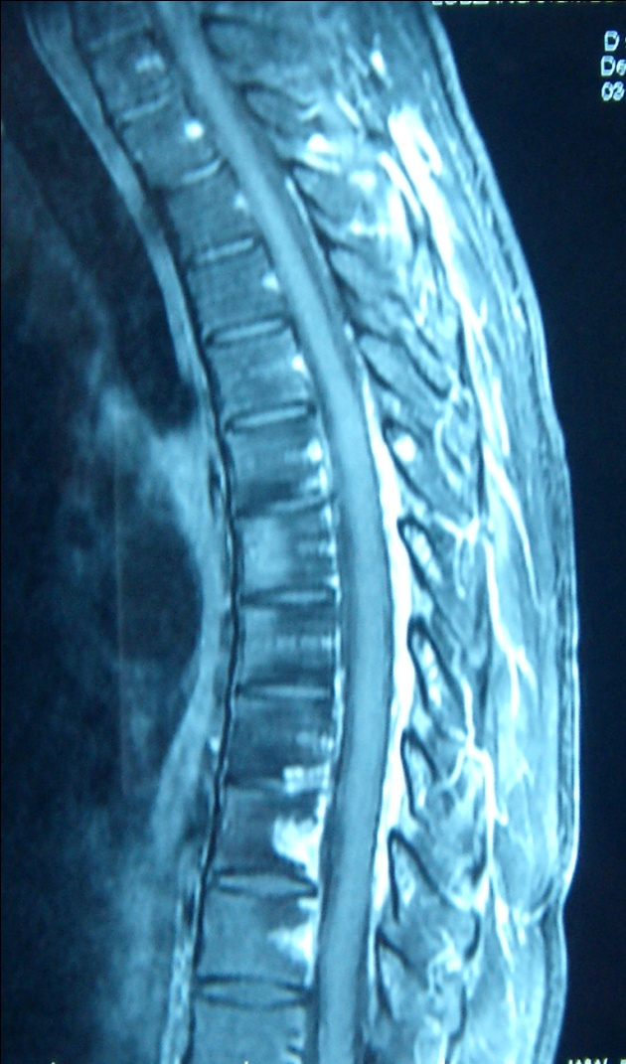
Enhanced T1-weighted magnetic resonance imaging with fat suppression show intense
enhancement of the subarachnoid space indicating arachnoiditis

Slide 32
Tuberculous pachymeningitis
Rare
Common sites of involvement are cavernous sinus, floor of middle cranial fossa and tentorium.
Radiographic features
CT
hyperattenuating solid plaque like densities (calcification may be seen)
MRI
    T1 : hypo intense thickened duramater.
    T2 : hypo intense thickened meninges.
    T1 C+ (GAD) : intense homogenous enhancement of thickened meninges.

Slide 33
Management
Medical therapy
Surgery
  indications
    Vision or life threatened by mass effect
    Failure of response to medical therapy
    Paradoxical increase in lesion size with therapy
    Diagnosis in doubt

Slide 34
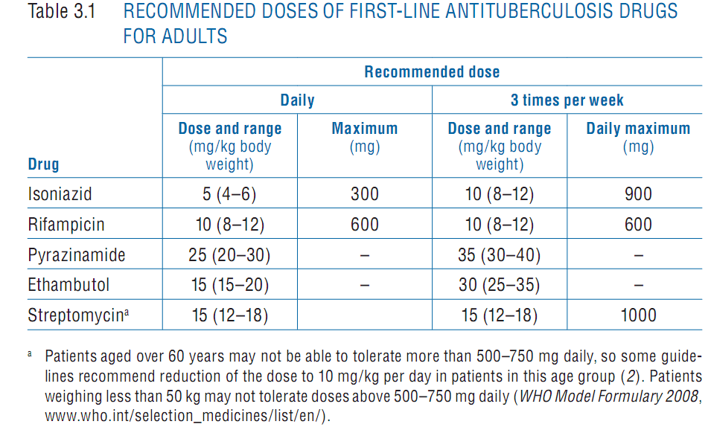
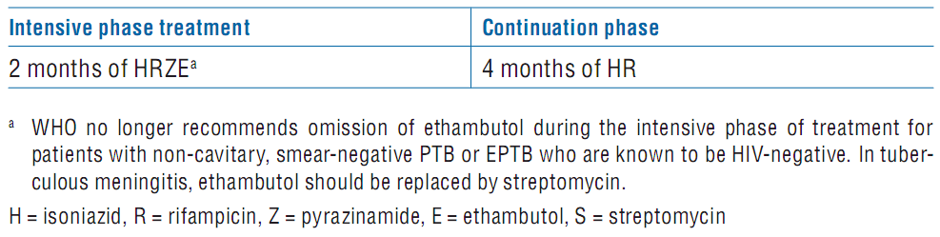
Medical therapy

Slide 35
WHO recommendations
PULMONARY AND EXTRA PULMONARY DISEASE SHOULD BE TREATED WITH SAME REGIMENS. NOTE THAT SOME EXPERTS RECOMMEND 9-12 MONTHS OF TREATMENT OD TB, MENINGITIS (2,3)GIVEN THE SERIOUS RISK OF DISABILITY AND MORTALITY, AND 9 MONTHS OF TREATMENT FOR TB OF BONES OR JOINTS, BECAUSE OF DIFFICULITIES OF ASSESING TREATMENT RESPONSE (3).UNLESS DRUG RESISTANCE IS SUSPECTED, ADJUVENT CORTICOSTERIODS TREATMENT IN RECOMMENDED FOR TB MENINGITISAND PERICARDITIS(1-4). IN TUBERCULOUS MENINGITIS, ETHAMBUTOL SHOULD BE REPLACED WITH STREPTOMYCIN.
2. National collabrating centre for chronic conditions. Tuberculosis : clinical diagnosis and management of tuberculosis, measures of its preventions and control. London royal college of physicians, NICE, 2006.
3. American thoracic society , CDC, infectious disease society of America. Treatment of tuberculosis morbidity and mortality weekly report: recommendations and reports,2003, 52(R-11):1-77.
WHO Treatment of tuberculosis: guidelines – 4th ed

Slide 36
Duration of treatment
6 months
van Loenhout-Rooyackers JH, Keyser A, Laheij RJ, Verbeek AL, van der Meer JW. Tuberculous meningitis: Is a 6-month treatment regimen sufficient? Int J Tuberc Lung Dis 2001;5:128-35.
12 months
Thwaites GE, Hein TT. Tuberculous meningitis: Many questions, too few answers. Lancet Neurol 2005;4:160-70
18 months or Longer
Santosh Isac Poonnoose, Vedantam Rajashekhar: Rate of Resolution of histologically verified intracranial tuderculomas. Neurosurgery 53:873-879, 2003

Slide 37
Treatment
Rate of radiological resolution of intracranial tuberculoma
Series duration of ATT residual lesions %
Wang 1996 (16) 6 20
Rajeshwari 1995 (6) 9 12
Awada 1998 (2) 12 0
Poonnoose 2003 (28) 18 69.2
Santosh Isac Poonnoose, Vedantam Rajashekhar: Rate of Resolution of histologically verified intracranial tuderculomas. Neurosurgery 53:873-879, 2003

Slide 38
Medical management
4 drugs x 3-4 months
2 drugs x 14-16 months occasionally longer
Regression of size from 4-6 weeks
Most resolve in 12-14 months
        R Patir, R Bhatia, Tandon PN. Surgical management of tuberculous infections of the nervous system. Schmidek and Sweet operative neurosurgical techniques 5th edition; 1617-1631
AED to continue
INH blocks phenytoin metabolism
Steroids in all irrespective of age and stage
Prasad K, Singh MB. Corticosteroids for managing tuberculous meningitis. Cochrane Database Syst Rev 2008;1:CD002244.

Slide 39
Resistant tuberculosis
MDR : resistant to INH and Rifampicin
EDR/ XDR : MDR + resistance to Quinolones and injectable second line drugs

Slide 40
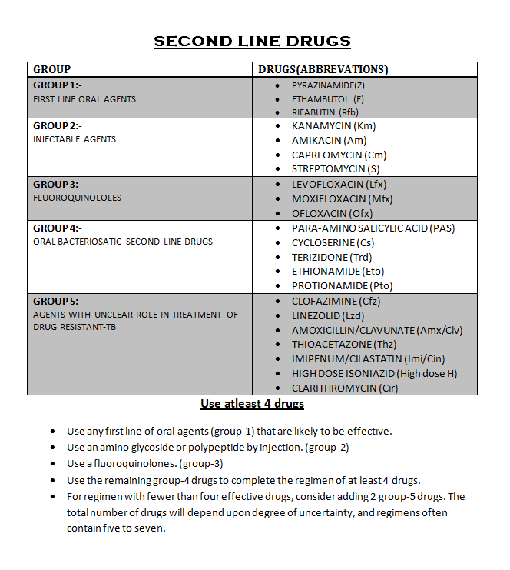

Slide 41
Surgery
Severe elevation of ICP
Threatening life or vision
Do not respond to drugs clinically/ radiologically
Diagnosis in doubt
Obstructive hydrocephalus
      R Patir, R Bhatia, Tandon PN. Surgical management of tuberculous infections of the nervous system. Schmidek and Sweet operative neurosurgical techniques 5th edition; 1617-1631
Aim diagnosis/ relieve pressure

Slide 42
Surgical management
Biopsy of the mass lesion
Hydrocephalus
      Communicating (commoner)
      Non communicating

Slide 43
Surgery principles
Non eloquent areas total excision (small lesion)
Subtotal/ partial excision (large lesion/ eloquent cortex)
Conservative excision around vital structures
Evacuation of central liquifactive portion in deep seated lesions
Residual lesions may respond to medical therapy
        R Patir, R Bhatia, Tandon PN. Surgical management of tuberculous infections of the nervous system. Schmidek and Sweet operative neurosurgical techniques 5th edition; 1617-1631
Hydrocephalus

Slide 44
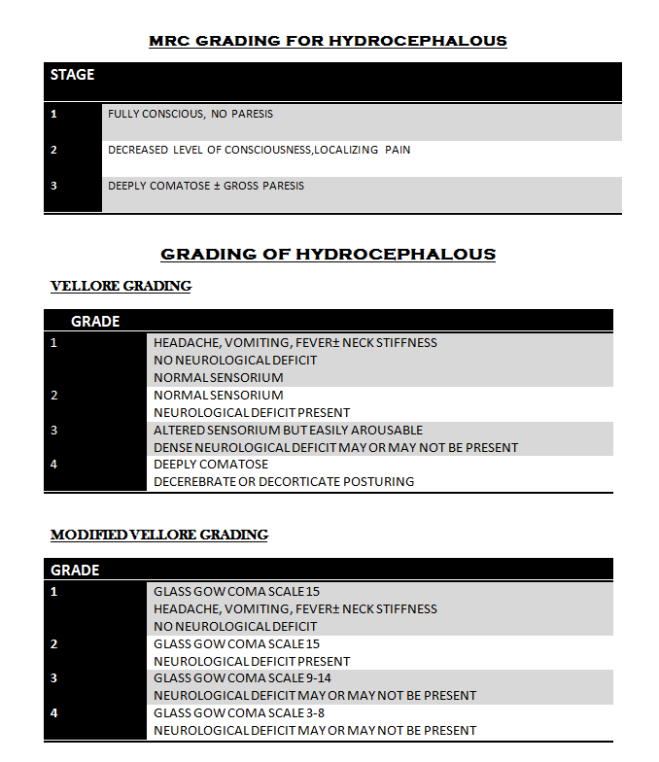

Slide 45
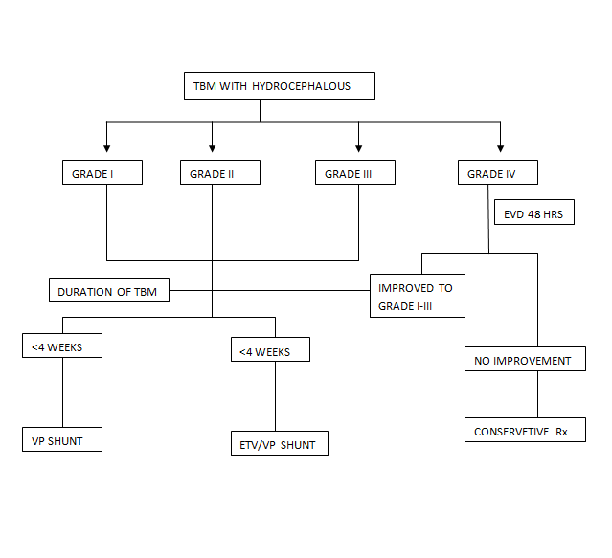

Slide 46
Hydrocephalus
Inevitable in those who survive 4-6 weeks
Mortality 20-100%
Grade at admission significant
Early shunt for grade I,II

Slide 47
ETV
    73.1% success rate for ETV in TBM with hydrocephalus
      A chugh, M hussain et al. Surgical outcome of tuberculous meningitis hydrocephalus treated by endoscopic third ventriculostomy: prognostic factors and postoperative neuroimaging for functional assessment of ventriculostomy: J Neurosurg Pediatrics 3:000–000, 2009
Endovascular revascularization for ischemia
STA MCA bypass
      The left superficial temporal artery–MCA bypass was found to be capable of preventing new ischemic events in the 21-month follow-up period
        Martin misch, Ultrich- wilhelm et al. Prevention of secondary ischemic events by superficial temporal artery–middle cerebral artery bypass surgery after tuberculosis-induced vasculopathy in a 5-year-old child:Neurosurg Pediatrics 6:000–000, 2010

Slide 48
AIIMS DATA (1975-1992)
SUPRATENTORIAL | 78
PARIETAL | 28
FRONTAL | 26
TEMPORAL | 15
BG / THALAMUS | 4
SELAR/SUPRASELLAR | 4
ORBITAL FISSURE | 1
INFRATENTORIAL | 50
CEREBELLUM | 44
CP ANGLE | 3
TENTORIUM | 1
BRAINSTEM | 2

Slide 49
Thank you

